Slide 1
Image Segmentation using UNet Architecture
Image segmentation -> Tensorflow tutorial
Adapted and Annotated by Kayla Neal

Slide 2
Data Loading
Using Oxford-IIIT Pet Dataset through tensorflow datasets
Each image in the dataset contains its corresponding label and its pixel-wise mask
Masks are class labeled for each pixel:
1 - belongs to object,
2 - borders object,
3 - surrounding object
Using tensorflow datasets requires:
import tensorflow_datasets as tfds
The data can then be loaded via:
Image color values are normalized to [0, 1], masks are initially [1, 2, 3], in normalization function, subtract one for convenience: mask pixels will then correspond to [0, 1, 2]
dataset, info = tfds.load(‘oxford_iiit_pet:3.*.*’, with_info = True)

Slide 3
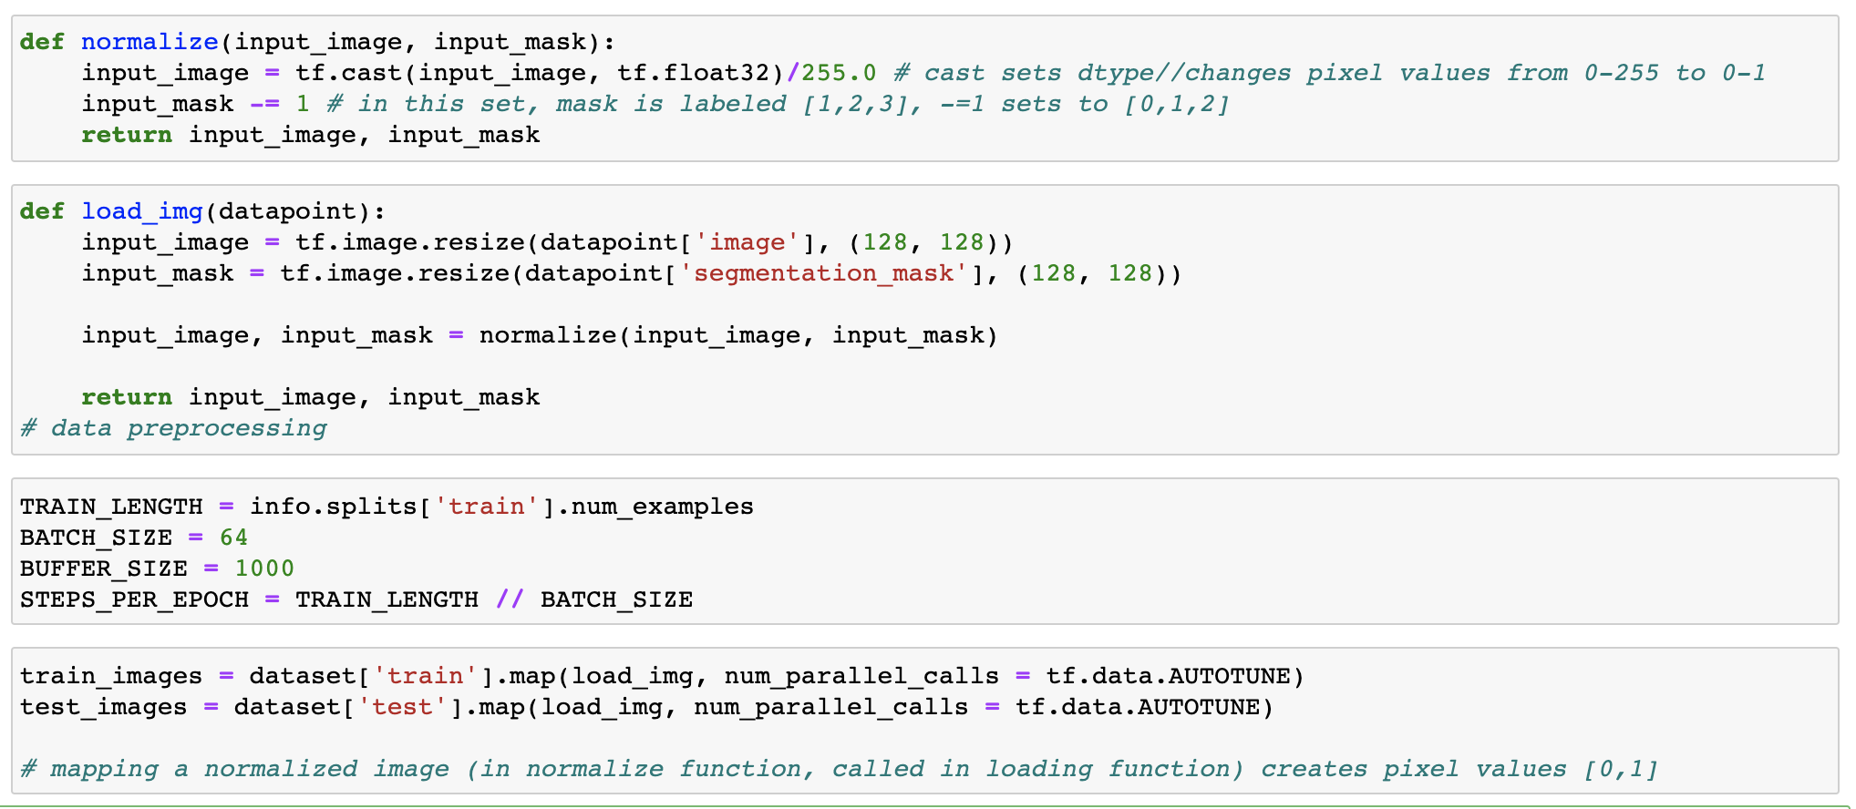
Data Processing
num_parallel_calls is an optional parameter. If not specified, the elements will be processed sequentially. AUTOTUNE sets the number of parallel calls based on available CPU
The map() function in tf applies the normalization to the designated pixel values
This tutorial separates the loading and normalization functions, then calls both in the map function.
The dataset already contains a split of testing and training data. This call allows the set split to be reused.
Notes:
https://www.tensorflow.org/api_docs/python/tf/data/Dataset#map

Slide 4
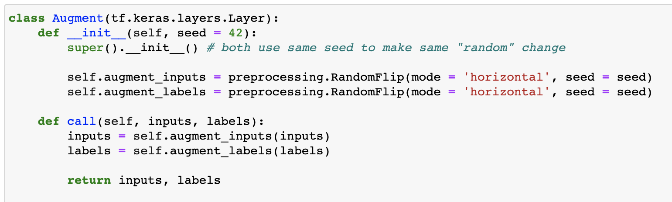
Data Augmentation
requires layer as input
flip can be vertical or horizontal
Data Augmentation is used to create variation in the dataset to help curb overfitting during training.
ONLY ACTIVE during testing (model.fit) and is ONLY APPLIED to testing dataset.
Creating a class or function for augmentation then mapping the augmentation to the training dataset is a standard workflow.
many types of augmentation: flip, rotate, resize, crop, saturate, etc.

Slide 5
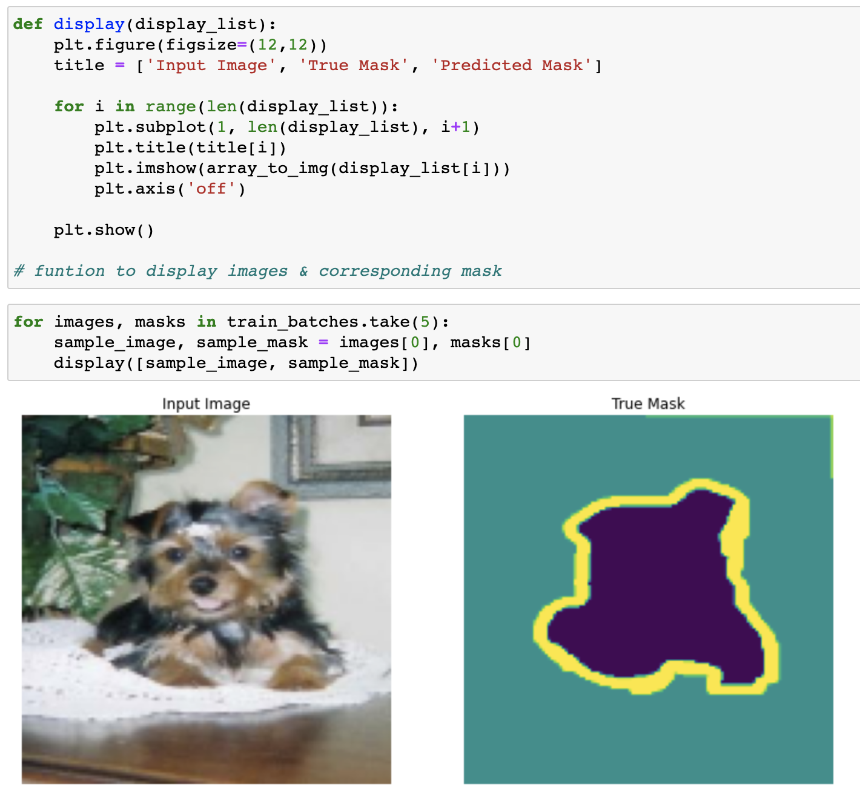
Creating Batches & Viewing Data
create display function for code reuse throughout program
With the data preprocessing and augmentation applied and/or defined, the testing and training batches can be made:
train_batches = ( train_images.cache(). shuffle(BUFFER_SIZE). batch(BATCH_SIZE). repeat(). map(Augment()). prefetch(buffer_size = tf.data.AUTOTUNE) )
test_batches = test_images.batch(BATCH_SIZE)
no masks predicted yet,
only display image and true mask (provided by dataset)
caches all elements in train_images
apply augmentation to train set ONLY
prefetch() is always used at the end of input pipelines.
allows later elements to be prepared while the current is being processed.
Notes:
https://www.tensorflow.org/api_docs/python/tf/data/Dataset#methods_2

Slide 6
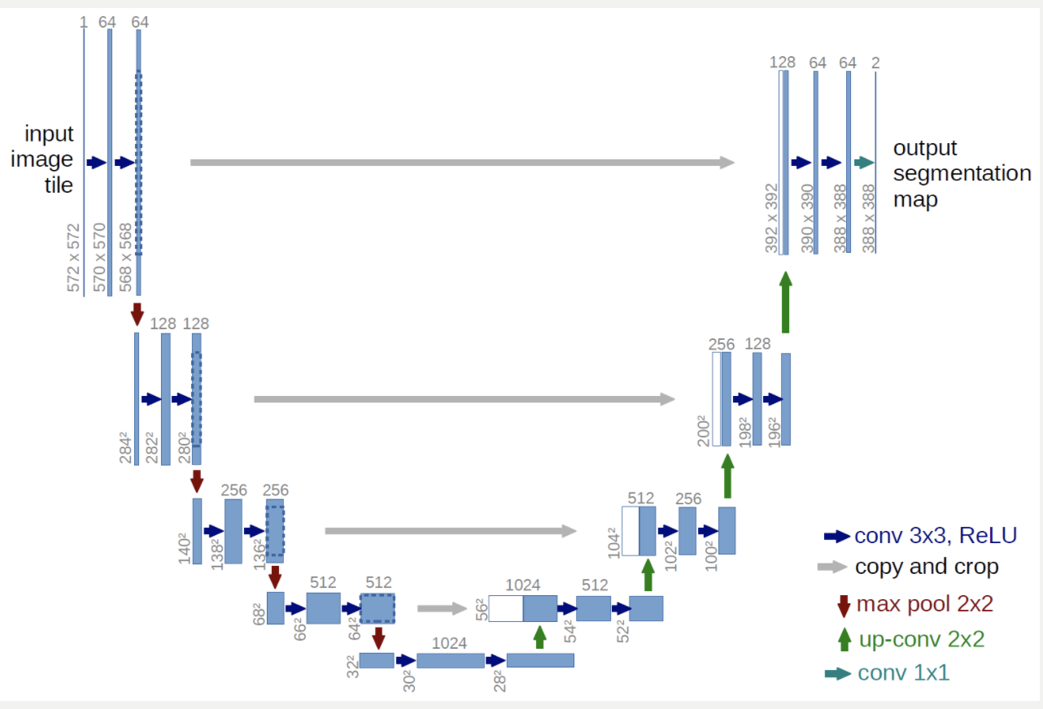
Create Model Following UNet Architecture
UNet is a CNN used for image segmentation. It was developed for biomedical images, which tend to have a small amount of training data (due to cost/size/availability/etc.)
information including the paper, download link, and further explanations can be found at UNet
Boiled down: the UNet model uses an encoder and decoder (downsampling and upsampling) to accurately classify images and create a segmentation map.

Slide 7
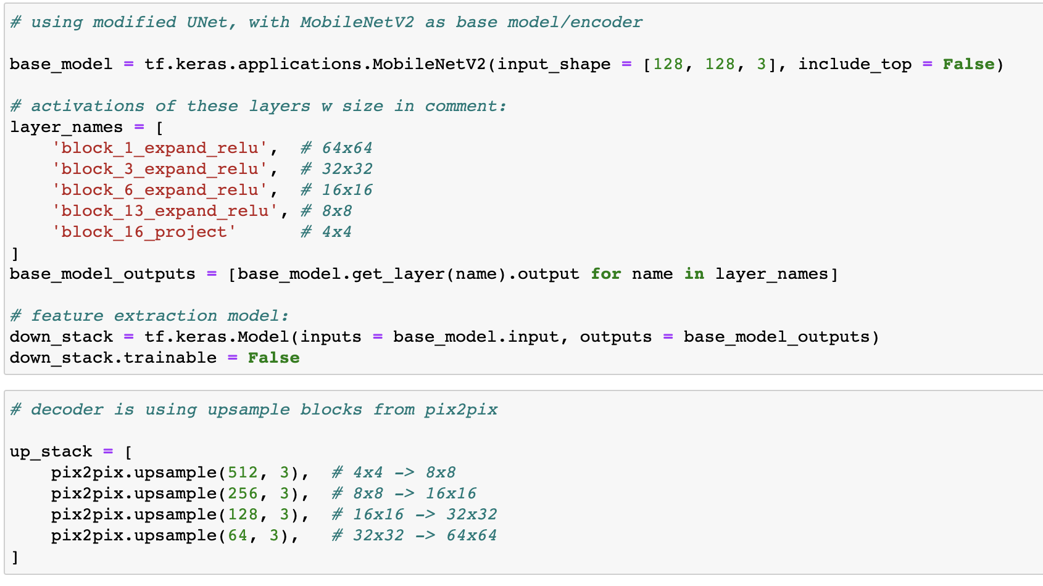
Creating UNet Model
Base Model
base models can be any pretrained model. VGG19 would also be a solid choice
Using MobileNetV2 as a base model for the image recognition tasks, start building up the components of the UNet architecture in the same manner as setting up a transfer learning model.
downsampling occurs throughout the classification process. connecting these layers into an output layer to create the downstack
pix2pix is conditional generative adversarial network that learns mapping from input images to output images.
A more in depth analysis can be found in on tensorflow’s pix2pix documentation page.
upsampling is used in the decoder of UNet, essentially building the images back up with the segmentation mask.

Slide 8
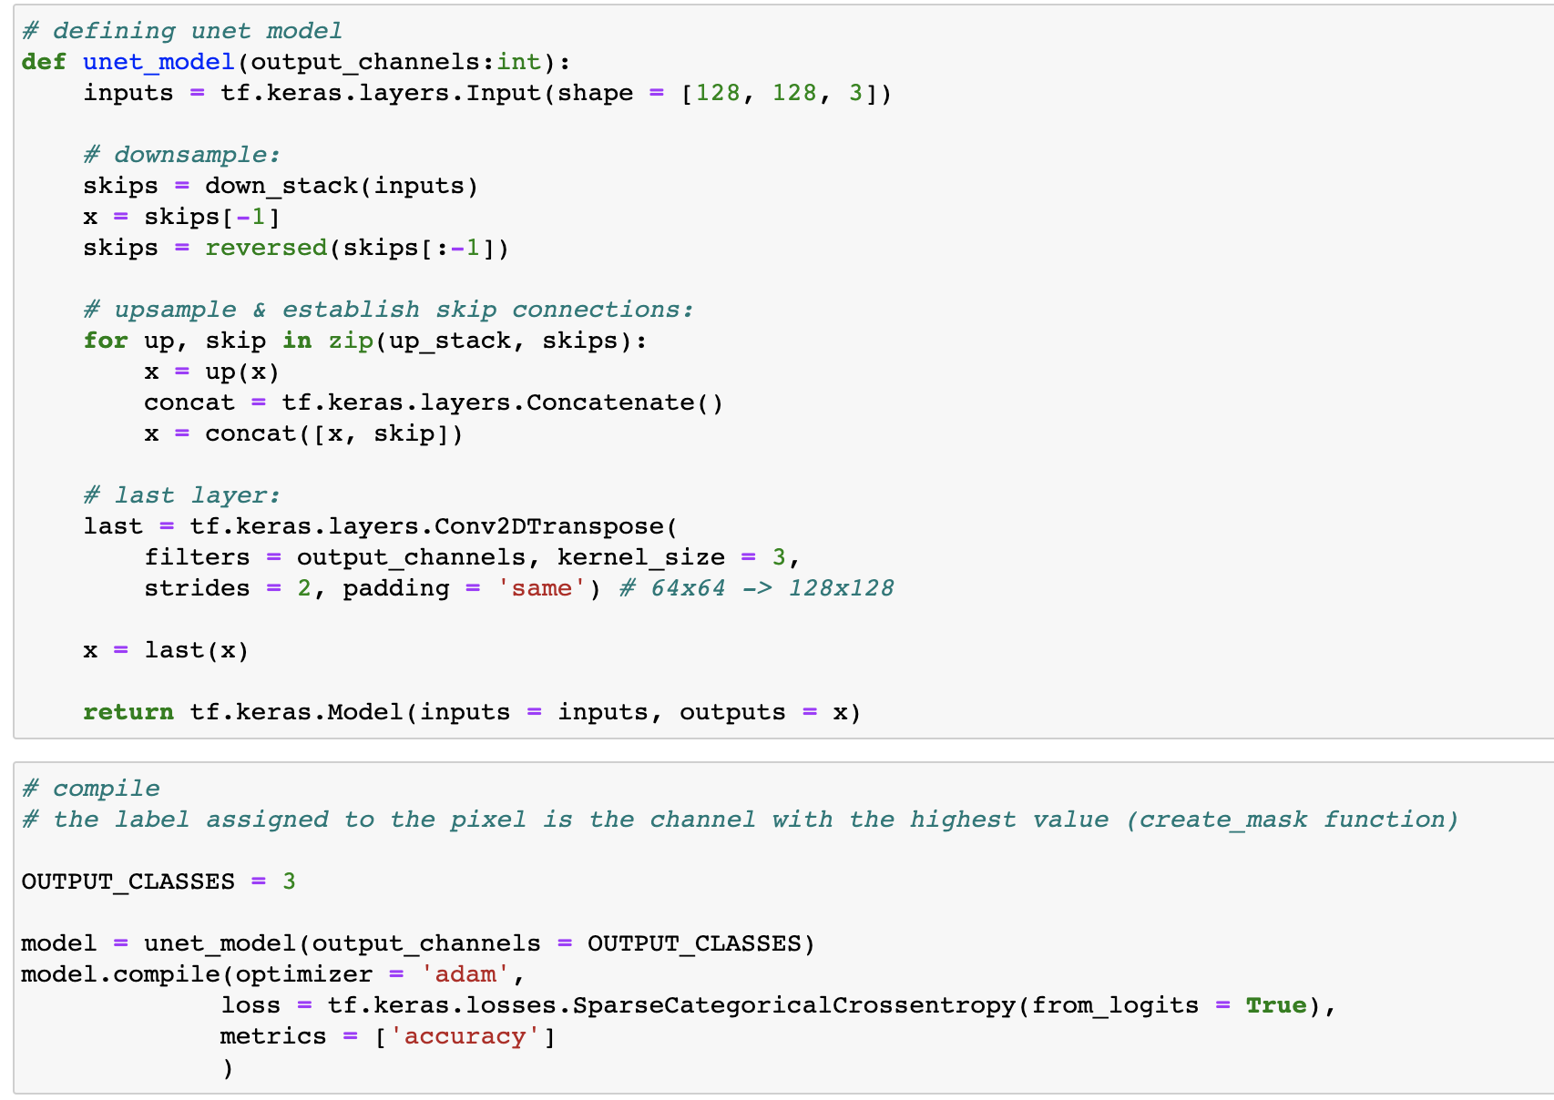
Creating UNet Model
Putting it all Together
down_stack is defined as a tf Model in the base model build section
skips are an important feature of the UNet model - connects the up and down sampling
up_stack is defined as the decoder in the base model build section
output channels
==
pixel distinctions

Slide 9
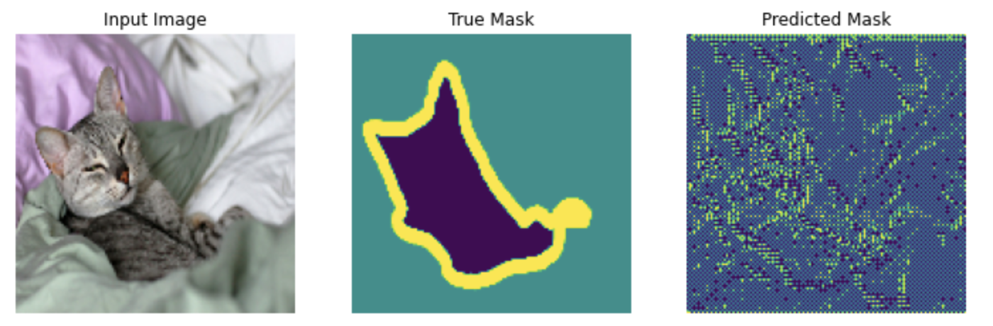
Creating UNet Model
Finishing Touches
Create a predicted mask:
def create_mask(pred_mask): pred_mask = tf.argmax(pred_mask, axis = -1) pred_mask = pred_mask[..., tf.newaxis] return pred_mask[0]
Show predictions: (that can be used as a callback!)
def show_predictions(dataset = None, num = 1) if dataset: for image, mask in dataset.take(num): pred_mask = model.predict(image) display( [image[0], mask[0], create_mask(pred_mask)] ) else: display( [sample_image, sample_mask, create_mask([model.predict (sample_image[tf.newaxis, ...]))] )
show_predictions() before training

Slide 10
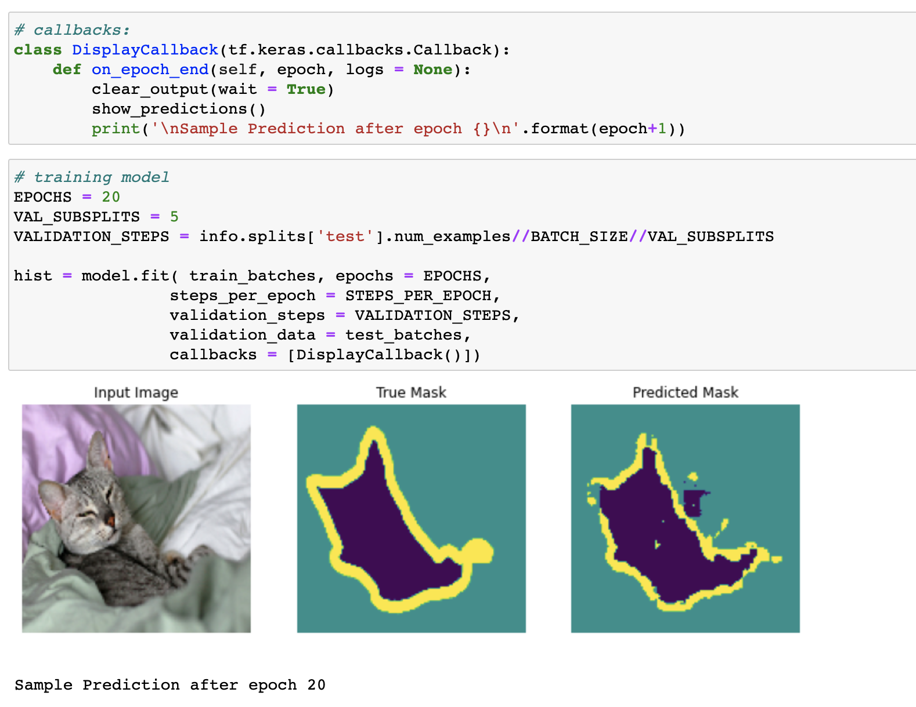
Training the Model
The last step before training the model is deciding on callbacks.
early_stopping() is a popular one to prevent overfitting
here, a custom callback is made to show the predictions [visualize the data] as training occurs.
more callbacks can be added here
an interesting comparison from before to after/during training!

Slide 11
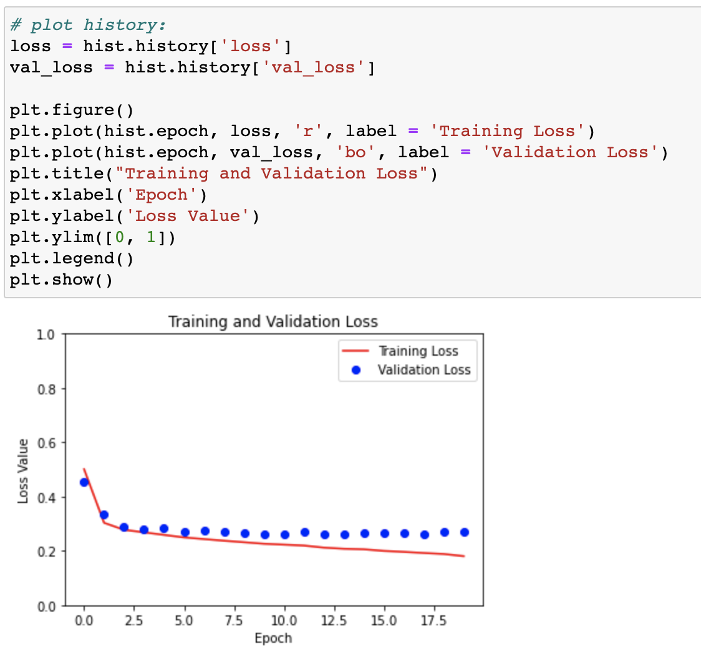
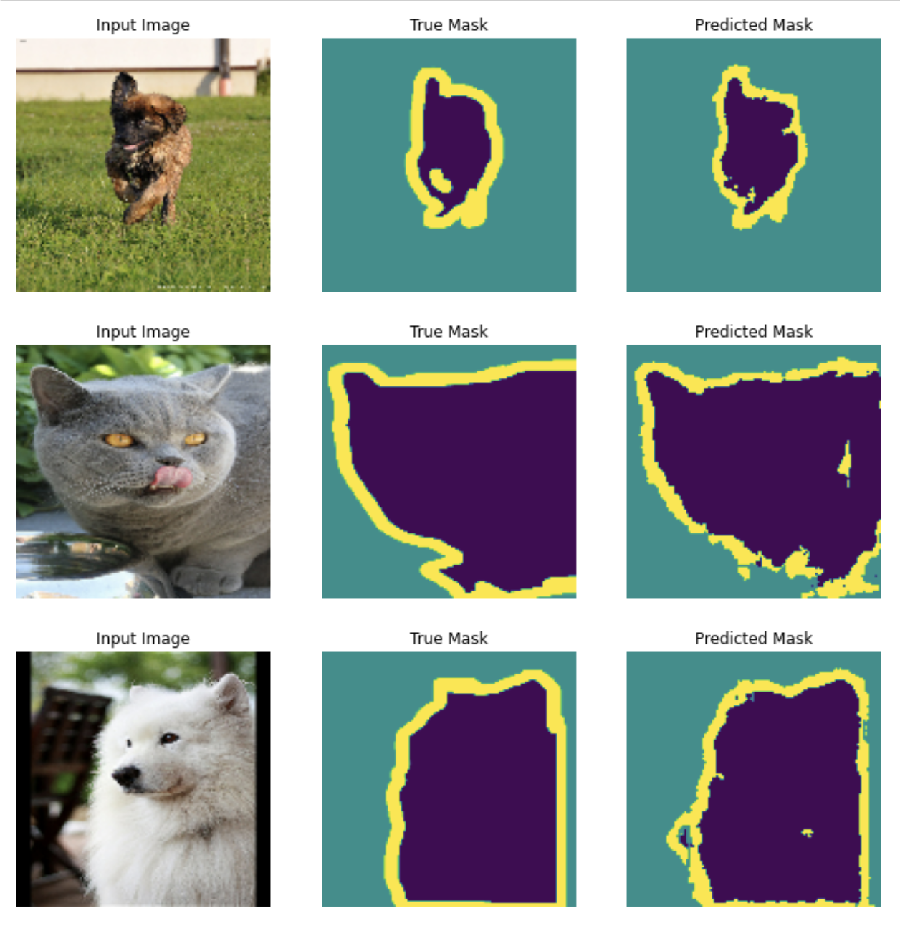
Plotting and Visualizing Data
using show_predictions() on random subset of images
learning curve produced after training
use tensorboard to view graph as training occurs

